Slide 1
Knapsack Problem
Given a set of items, each with a weight and a value, determine a subset of items to include in a collection so that the total weight is less than or equal to a given limit and the total value is as large as possible.

Slide 2
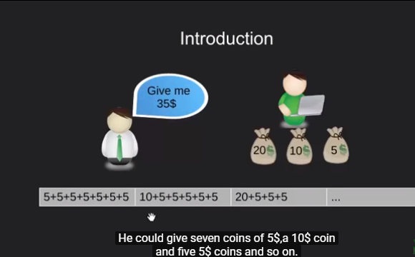

Slide 3
Applications
Finding the least wasteful way to cut raw materials
portfolio optimization
Cutting stock problems

Slide 4
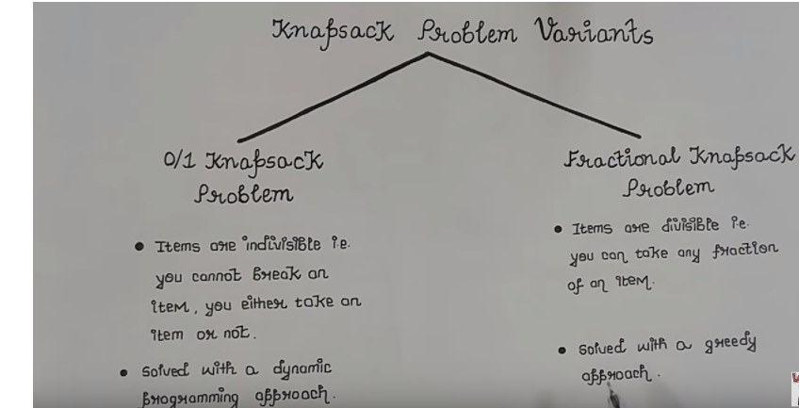

Slide 5
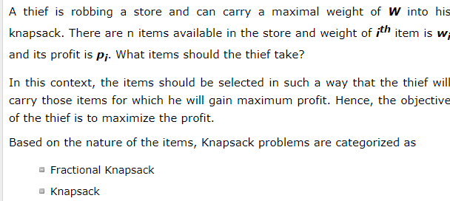
Problem Scenario

Slide 6
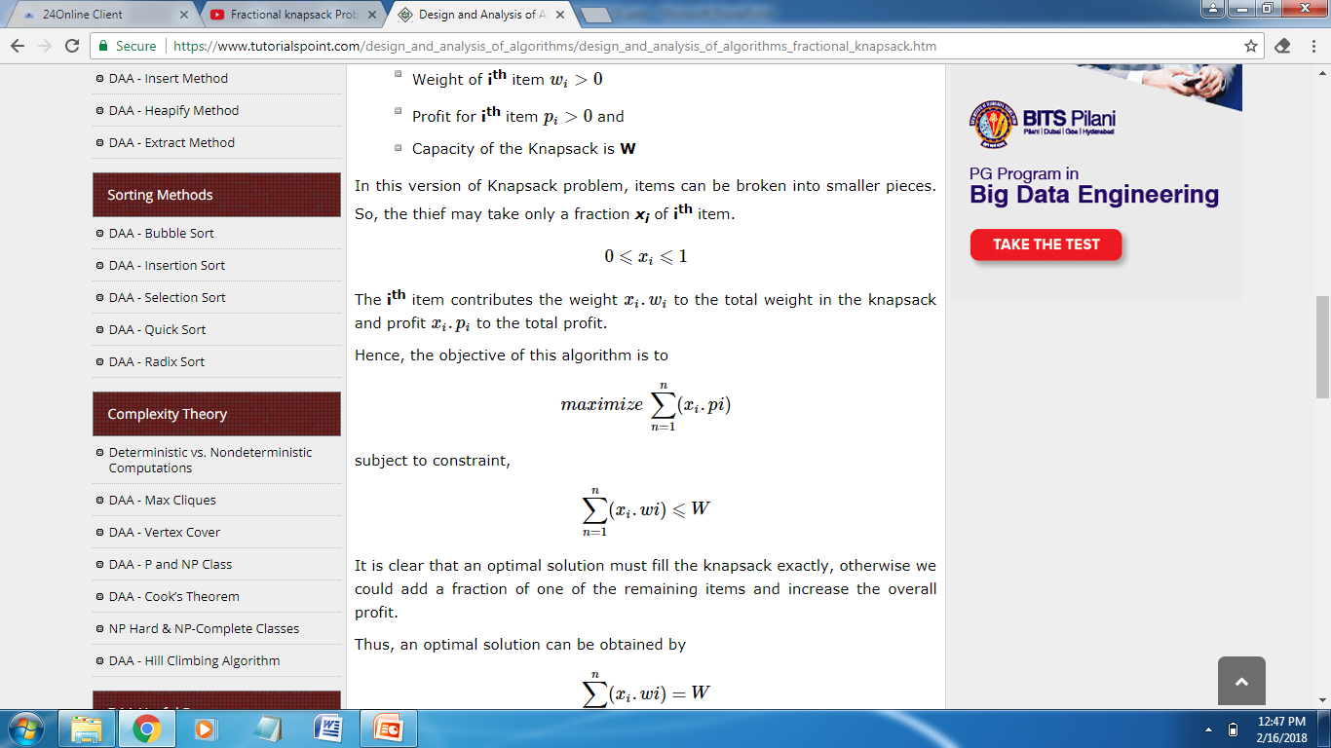
Problem
N number of items
Wi. . . . . . . . Wn Weight associated with items
Pi . . . . . . . . Pn Profit associated with items
Knapsack with certain capacity

Slide 7
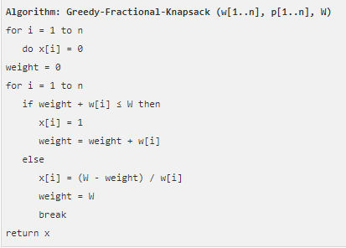
Algorithm

